Slide 1
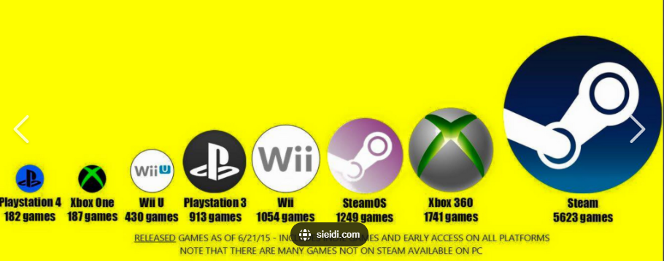
EDA
GROUP 5
VIDEO GAME SALES

Slide 2
INTENDED FOR:
Entrepreneurs that are interested in setting up a game shop
Companies that want to develop video games
Companies that want to develop a gaming platform

Slide 3
HYPOTHESIS
How popular a product is in a specific period of time and geographical space, correlates with its demand by consumers.
Increase in demand by consumers, results in increase in profit earned by a marketing body
As such popularity of a product sold by a marketing body can result in an increase in profits

Slide 4
DATA DESCRIPTION
Has 16,599 tuples
Has 11 Fields or attributes which includes:

Slide 5
DATA DESCRIPTION - FIELDS
Rank - Ranking of Overall(Global) sales
Name - The Game’s name
Platform - Platform compatible with the game
Year - Year of the game's release
Genre - Genre of the game
Publisher - Publisher of the game

Slide 6
DATA DESCRIPTION - FIELDS
NA_Sales - Sales in North America (in millions)
EU_Sales - Sales in Europe (in millions)
JP_Sales - Sales in Japan (in millions)
Other_Sales - Sales in the rest of the world (in millions)
Global_Sales - Total worldwide sales.

Slide 7
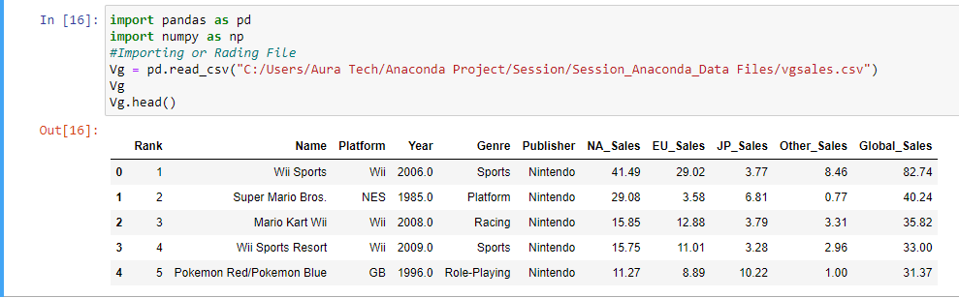

Slide 8
DATA DESCRIPTION – RELIABILITY
Presence of Null Values
Absence of Duplicates
As such, Data Set was fairly good for Analysis

Slide 9
QUESTION
Testing our Hypothesis

Slide 10
In a given period of time, Does Global Sales depend on Popularity of a Gaming Specification

Slide 11
DEPENDENCIES
Which attributes were employed in our analysis

Slide 12


GAMING SPECIFICATIONS
Genre : What is the Type of the Game
Platform : Which Hardware supports the gaming environment
Publisher: Which Organization released the Game

Slide 13
YEAR
In the Attribute Year, in our Data Set, Values ranged from 1980 to 2020
Also there were Null Values Present
The Data Set was Filtered based on Year Groupings, such Groupings includes:
From 1980 – 1999, termed as 20th Century
From 2000 – 2020, Termed as 21st Century
All Null Values. Termed as Unknown Years

Slide 14
ANALYSIS
How do we employ our dependencies in testing the hypothesis

Slide 15
POPULARITY IN EACH YEAR GROUPING
Based on Plaforms
Based on Genre
Based on Publisher

Slide 16
AVERAGE OVERALL(GLOBAL) SALES IN EACH YEAR GROUPING
Based on Plaforms
Based on Genre
Based on Publisher

Slide 17
ASSUMPTION
What conditions did we set for proving the hypothesis

Slide 18
What to Expect
4 Most popular Genres, Platform, and Publisher in each year groupings – out of which the most popular in each specification is singled out
4 Most Highest Average_Overall_Sales made according to Genre, Platform, Publisher in each Year Groupings – out of which the highest in each specification is singled out
As such, 6 deductions will be made in each year grouping, making it a total of 18 deduction in all year groupings

Slide 19
WHAT TO EXPECT – DIAGRAMMATIC REPRESENTATION
H.P– Highest Popularity H.A.O.S –Highest Average Overall Sale
Year Grouping | Genre |  | Publisher |  | Platform
 | H.P | H.A.O.S | H.P | H.A.O.S | H.P | H.A.O.S
20th Century
21st Century
Unknown Years

Slide 20
ASSUMPTION - STATEMENT
Year Grouping | Genre |  | Publisher |  | Platform
 | H.P | H.A.O.S | H.P | H.A.O.S | H.P | H.A.O.S
20th Century
21st Century
Unknown Years

Slide 21
PLATFORM AND LIBRARIES
Python IDE (Jupyter Notebook)
Pandas
Matplotlib
Seaborn

Slide 22
PROCESSES
Cleaning the Data – We changed all Null Values to 0
Filtering – We filtered the Data Sets based on our Year Groupings
Proceeded with our Analysis
Visualized our Analyzed Data

Slide 23
VISUALIZATION
A Summary of everything analyzed

Slide 24
POPULARITY
Year Group = 20th Century

Slide 25
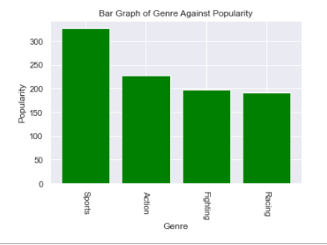
GENRE

Slide 26
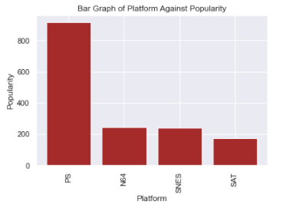
PLATFORM

Slide 27
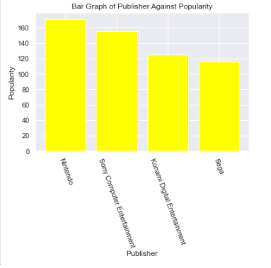
PUBLISHER

Slide 28
POPULARITY
Year Group = 21stCentury

Slide 29
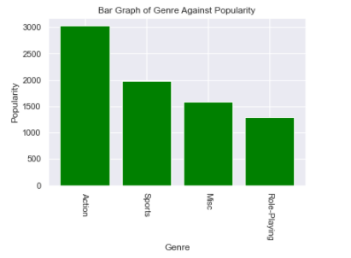
GENRE

Slide 30
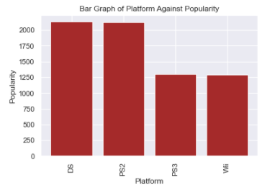
PLATFORM

Slide 31
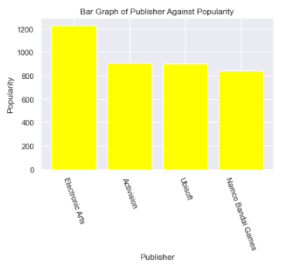
PUBLISHER

Slide 32
POPULARITY
Year Group = Unknown

Slide 33
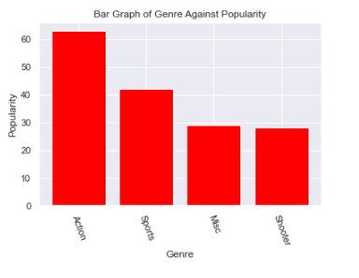
GENRE

Slide 34
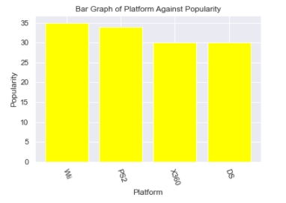
PLATFORM

Slide 35

PUBLISHER

Slide 36
AVERAGE OVERALL SALES
Year Group = 20th Century

Slide 37
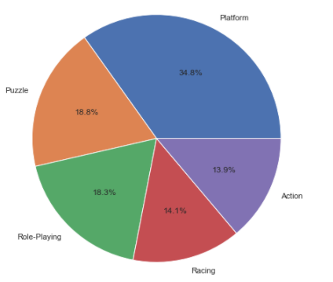
GENRE

Slide 38
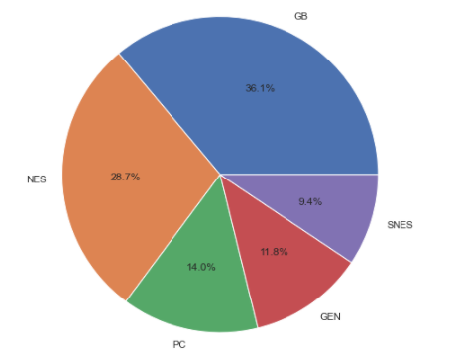
PLATFORM

Slide 39
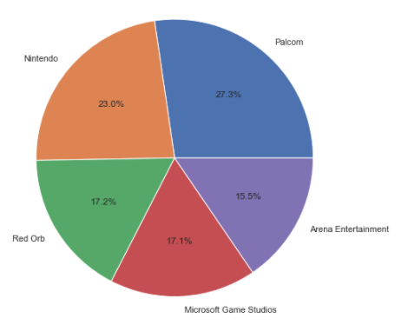
PUBLISHER

Slide 40
AVERAGE OVERALL SALES
Year Group = 21stCentury

Slide 41
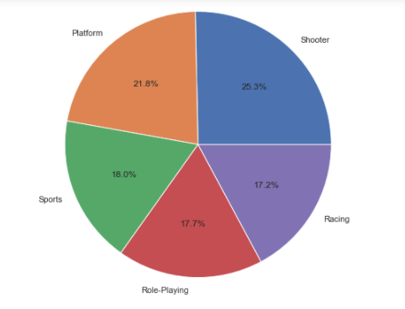
GENRE

Slide 42
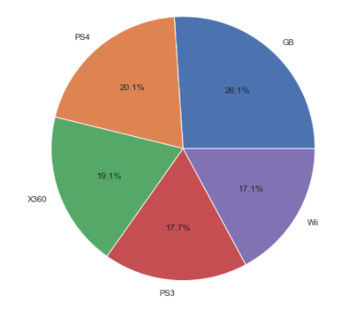
PLATFORM

Slide 43
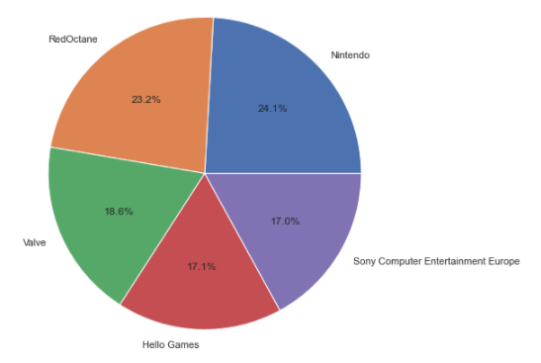
PUBLISHER

Slide 44
AVERAGE OVERALL SALES
Year Group = Unknown Year

Slide 45
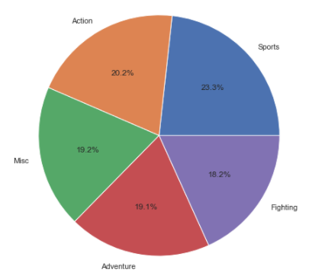
GENRE

Slide 46
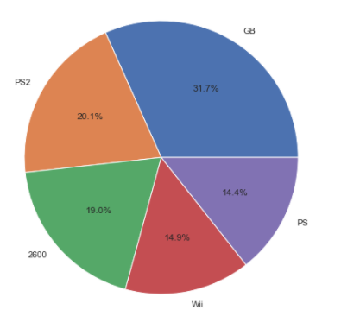
PLATFORM

Slide 47
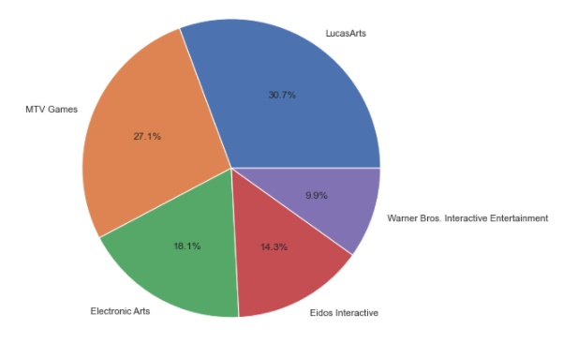
PUBLISHER

Slide 48
DEDUCTIONS AND CONCLUSION
Does the Hypothesis apply Here

Slide 49
DEDUCTIONS
Absence of correlation between popularity and Average_Global_Sales in all dependencies
This might be due to specifying the whole Continent as one using the Global_Sales
And Might also be due to finding the Average of the Global Sales per Dependency (Type of Genre, Publisher and Platform)

Slide 50
CONCLUSION
The data_set does not satisfy our hypothesis
As such, though popularity can affect demand, it should not always be used as a primary condition for the selling of gaming products

